Slide 1
Digital Preservation 101, or, How to Keep Bits for Centuries
Julie C. Swierczek
Digital Asset Manager & Digital Archivist
tpverso.wordpress.com
@JulieSwierczek
Good luck spelling that!

Slide 2
Digital Preservation 101, or, How to Keep Bits for Centuries
Julie C. Swierczek
Digital Asset Manager & Digital Archivist
tpverso.wordpress.com
@JulieSwierczek
Good luck spelling that!

Slide 3
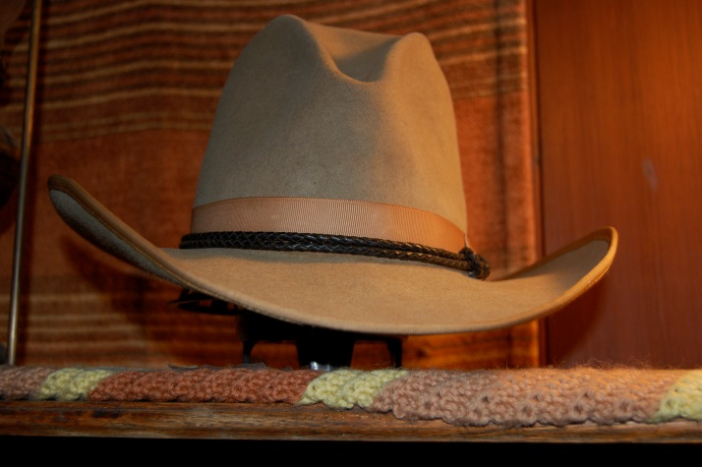
the condensed edition
Hold on to your
Good luck spelling that!
Notes:
<pause>

Slide 4
Notes:
When I talk about *digital preservation*, many people think I am talking about…

Slide 5
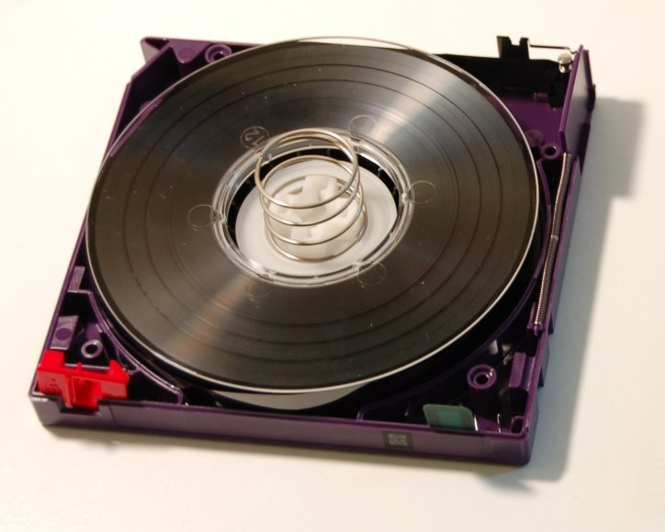
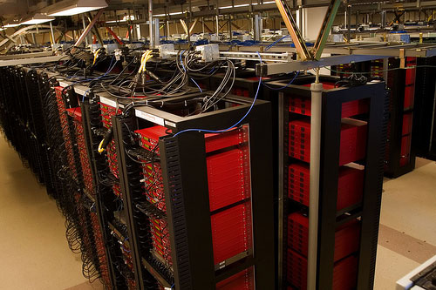
Notes:
…digital storage. And when I say “digital archive”, most people think I mean a….

Slide 6
Notes:
…”backup copy”, or even…

Slide 7
Notes:
a zip file or tarball. But that’s not it, either.
So…

Slide 8
Notes:
…what is digital preservation?

Slide 9
Notes:
It’s rocket science.
No, seriously. In 1982, NASA and the other major space agencies realized they had a data problem, so they worked together to develop data system standards for spaceflight.

Slide 10
Consultative Committee on Space Data Systems
(CCSDS)
Notes:
They called themselves the Consultative Committee on Space Data Systems.

Slide 11
CCSDS 650.0-M-2, Reference Model for an Open Archival Information System (OAIS)
Notes:
One of their publications is the Reference Model for an Open Archival Information System, aka the OAIS.

Slide 12
ISO14721:2012:
Space data and information
transfer systems – Open archival information system (OAIS)
-- Reference model
Notes:
The OAIS is also an ISO standard.

Slide 13
Notes:
It looks something like this. This is a fun slide, but you probably can’t see it clearly, so…

Slide 14
Notes:
here’s a more simplified version.
Now, one thing to keep in mind about the OAIS model is that…

Slide 15
Notes:
It’s only a model. Implementation will depend on resources and what you are trying to achieve.

Slide 16
Notes:
Here’s the basic idea: a producer submits content which is then ingested into the system. As part of the ingest process, descriptive and technical information about the content is captured.

Slide 17
Notes:
The content goes to archival storage, and there is a data management layer that tracks the descriptive and technical information and other metadata.

Slide 18
Notes:
Notice the overarching emphasis on preservation planning, administration, and management. Those aren’t just afterthoughts slapped on to a storage system. They are key components of the model. You could build a technologically perfect digital storage system, but if you are lacking certain administrative features – which includes things like…

Slide 19
SUSTAINABLE FINANCING
Notes:
sustainable financing – then it really doesn’t adhere to this…

Slide 20
Notes:
model and it’s likely to fail.

Slide 21
Notes:
On the right, we have a consumer who requests access. A copy of the content and of the associated information is then packaged and shared with the consumer.

Slide 22
Key principles of archives
Notes:
To understand why the model works the way it does, let’s look at two key principles of archives.

Slide 23
Provenance
Notes:
Provenance refers to the *origin* of the records or papers. Knowing the *connection* to the source is important for evaluating the *authenticity* of a document.

Slide 24
Original order
Notes:
The second important principle of archives is that of *original order*.

Slide 25
order matters
Notes:
The order *matters*.
When did this author first develop this idea?
When did Volkswagen’s leadership know that they were installing defeat devices to cheat emissions testing?

Slide 26
How do you deal with authenticity
and
original order
in a digital realm?
Notes:
How do you deal with authenticity and original order in a digital realm? The model provides a path.
*However*, before I get into details, keep in mind that…

Slide 27
something is better than nothing
Notes:
…*something* is better than nothing. We’re trying to beat the clock here. If we don’t make any attempts to preserve digital content until we have ‘enough’ money, or a ‘perfect’ preservation system, the content will disappear before we have a chance to preserve it.

Slide 28
Notes:
Think about it: The Atra-Hasis, an Akkadian epic, is recorded on clay tablets that are nearly 3,000 years old. You can preserve those things just by leaving them lying around in good environmental conditions.

Slide 29
I searched for an image of a melted floppy disk, and found this Black-haired Silkie Guinea pig instead.
Notes:
Try *that* with a floppy disk.
<pause>

Slide 30
Notes:
So, how do we get this stuff?

Slide 31
Notes:
We use principles of digital forensics, including things like hardware writeblockers, to ensure data remains intact during transfer.
Sometimes we have to use things like…

Slide 32
FC5025 USB 5.25” floppy controller
KryoFlux
Notes:
the FC5025 USB five-and-a-quarter floppy controller. Or a KryoFlux, which costs a small fortune. The KryoFlux, by the way, sounds like something in…

Slide 33
Notes:
…the Large Hadron Collider.
For those devices, you have to supply your own five-and-a-quarter floppy drive, which is why…

Slide 34
eBay is the digital archivist’s friend
Notes:
eBay is the digital archivist’s friend. *And* we have gone down the rabbit hole that is…

Slide 35
Retrocomputing or
vintage computing
Notes:
Retrocomputing or vintage computing.

Slide 36
nowseethis.org
The Invisible Photograph
Part 2: Trapped
Notes:
Nowseethis.org has a cool video of Amiga fans rescuing Andy Warhol’s computer art from oblivion.

Slide 37
Notes:
I don’t know *WHY* they saved it from oblivion…

Slide 38
Did I mention that I work in an art museum?
Notes:
…but they did.
<pause>
At this point in the process, we wrap the incoming data with some information, and we call it a…

Slide 39
SIP
Submission Information Package
Notes:
SIP.
We also calculate checksums of files…

Slide 40
I couldn’t find a picture of a checksum.
Notes:
…so we can verify that they remain unchanged during ingest and throughout their lifetimes.

Slide 41
Notes:
Next, we want to prepare the content for its final resting place.
Sort of.

Slide 42
PREMIS
PREservation Metadata: Implementation Strategies Working Group
Notes:
To do that, we’re going to need to set up some metadata.
Because…

Slide 43
Notes:
METADATA.
This will be part of a robust…

Slide 44
Data management layer
Archival storage
Notes:
data management layer.
We are also going to need to store the original file…

Slide 45
Notes:
…along with a derivative copy in…

Slide 46
Notes:
…a long-term preservation format.
What formats are those?

Slide 47
Library of Congress
National Digital Information Infrastructure and Preservation Program
(NDIIPP)
Notes:
Ask the folks at NDIIPP. They do research….

Slide 48
Digital Formats Sustainability
www.digitalpreservation.gov
Notes:
…on Digital Formats Sustainability.
Then, we’ll wrap the files and the metadata in a package, and call it an…

Slide 49
Notes:
APE.
Sorry, it’s an…

Slide 50
AIP
Archival Information Package
Notes:
“APE”. An Archival Information Package.
Then we have to…

Slide 51
Notes:
store the AIPs.
We want to store…

Slide 52
Notes:
multiple copies in…

Slide 53
Notes:
multiple geographic locations…

Slide 54
Notes:
on more than one kind of storage media.
We will be monitoring the storage for long-term…

Slide 55
Notes:
…durability and accessibility.
But…

Slide 56
Notes:
…we’re not done yet.

Slide 57
Notes:
We have to monitor file format obsolescence over the life of the file.
As formats become obsolete, we need to create…

Slide 58
Notes:
…new derivatives from the original, or, if that is not possible, new derivatives from the previous ones.
We also need to monitor…

Slide 59
Notes:
…storage obsolescence over the life of the file.
These are all facets of…

Slide 60
Notes:
…administering the system over time…

Slide 61
Notes:
…for decades and centuries.

Slide 62
Notes:
We’re also going to record all actions taken on the files so that the…

Slide 63
Notes:
…chain of custody is transparent.
Given everything I’ve said….

Slide 64
Notes:
…if anyone tells you that you should get a ONE-TIME grant for digital preservation…

Slide 65
Notes:
…you have my permission to get mad.
Finally, we want to deliver these files to consumers.

Slide 66
Notes:
We wrap up copies of the files for delivery, along with necessary data, and we call that a…

Slide 67
DIP
Dissemination Information Package
Notes:
DIP.
Let me be clear, we call the packet of *content* a DIP.

Slide 68
consumer ≠ dip
Notes:
We do not call the content *consumer* a dip….

Slide 69
Notes:
That would be rude.

Slide 70
Notes:
The last question is about accessing that content in the future.

Slide 71
Notes:
We can do retrocomputing for a while.

Slide 72
Multi Emulator Super System (MESS)
www.mess.org
Notes:
But we’re probably going to have to do emulation.

Slide 73
Notes:
You may have seen the Internet Archive’s port, JSMESS, running their Console Living Room.

Slide 74
Notes:
Carnegie Mellon’s Olive Archive is testing the idea of including…

Slide 75
Notes:
virtual machines with the content to maintain accessibility.
Now, I know what you’re thinking…

Slide 76
Notes:
So what? What does that have to do with me?

Slide 77
Notes:
When you start building a digital project, think about the long-term preservation.

Slide 78
Notes:
Maybe you’ll decide you don’t need to save the content forever.

Slide 79
Notes:
But if you want to keep it, think about all of these facets, and…

Slide 80
SUSTAINABLE FINANCING
Notes:
sustainable financing…

Slide 81
Notes:
…before you begin.

Slide 82
tpverso.wordpress.com
Special thanks to the creators of all of the open culture
I used in this presentation.
Notes:
There is a handout on my wordpress site with links from this talk plus a bunch of fun stuff that I had to cut.
Thank you.

