Slide 1
Get Ur Recon
christina harlow http://bit.ly/GetUrRecon
Notes:
Hi, I’m Christina Harlow, and I work on metadata at Cornell University. My slides and speaker’s notes - which I’ll try to follow closely - are available at that bit.ly link. With that, let me move to my actual starting slide…

Slide 2
Get Ur Recon
christina harlow http://bit.ly/GetUrRecon
Notes:
So today I’ll be talking about reconciliation, otherwise known as entity matching, otherwise known as one of the big elephants in the linked data in libraries’ room. But this talk is also a brief narrative of my work in library metadata so far and how much reconciliation work overlaps with a lot of my experimentation and goals. With that said, let’s go back in time…

Slide 3
...
& I can’t stand the names searched manually
...
Notes:
Let me talk about a project workflow and project blocker that probably sounds familiar to a number of folks here today.
The project narrative goes: someone discovers that it would be great if we had this database that pulled data from all these other sources. But our database focuses on bringing together data around these entities other data sources treat as secondary. We could offer all new functionality around searching, linking, understanding these entities!
Go get the various datasets, flatten into tabular formats, then realize, damn, our data is messy. How to align entities we wish to focus on? We don’t want to not have the same people not linked because their names vary. But we also don’t want to link together different folks who share a part or all of a common name…

Slide 4
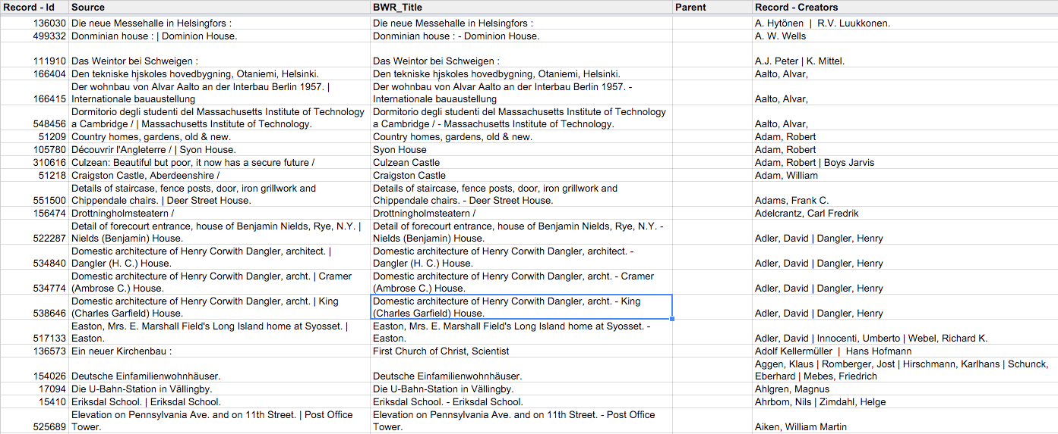
Man, our data is messy…
I know, let’s hire a Student Worker, Intern, or Staff…
Notes:
But how to clean and normalize these names? Get them linked to an external authority - for this project, Getty ULAN?
I know! Let’s hire a student or get a staff person to do this.

Slide 5
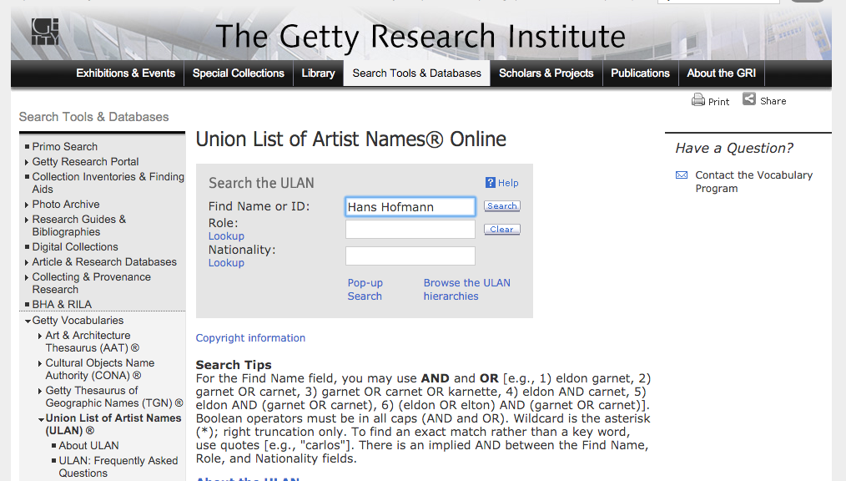
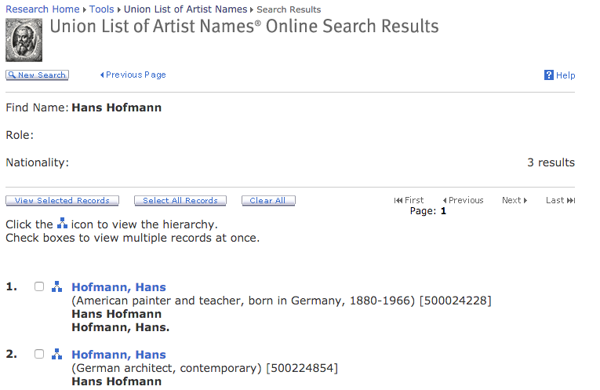
Manually search name...
...select best match
Notes:
Enter Christina into her first metadata-focused job in libraries. In doing this searching, you go through some basic (or seem so) steps:
Manually search names in authorities.
Choose best option (what is involved in this becomes a sticking point in replicating human judgment in scripting and data understanding).

Slide 6
...paste just the heading back in...
Notes:
Pull just the ‘heading’ back in. Why not the identifier?

Slide 7
repeat forever…
dying of boredom…
entering lots of errors…
Notes:
Repeat the above steps, again and again, forever and ever, dying of boredom, entering lots of unintentional errors…

Slide 8
…or don’t.
Notes:
Or don’t.
There must be a better way to accomplish this.
Luckily, I was presented this work in tandem with some freedom to explore new ways to do it, and a few tools that were presented as ‘may be of use’, although initially for the data munging portions alone.

Slide 9
I know you dig the way I switch my workflow
Notes:
So we look at switching workflows with the tools involved.

Slide 10
&&
Linked Open Data (LOD) Refine
github.com/sparkica/LODRefine
Notes:
Early on, OpenRefine (openrefine.org) was offered as something I could use to help with data munging work. OpenRefine is a tool many here are probably aware of, and I’m not going to go into it at length (though there are links in my slides to more information). It was originally presented as a way to do data normalization, but two things stood out:
- the OpenRefine Standard Reconciliation Service API
- the Linked Open Data Refine (or LODRefine) SPARQL Reconciliation Service
I need to stop here for a second to touch on what I mean by reconciliation - this and my work on it going forward having been heavily influenced by this introduction to OpenRefine.

Slide 11
Reconciliation
Things/URIs <=> Things/URIs
Entity Resolution
Strings/Labels <=> Things/URIs
Lexicalization
Things/URIs <=> Strings/Labels
Entity Matching Generally
Notes:
Reconciliation in the context of how I work (and in that of OpenRefine) is that I have some data describing an entity, I’m going to match it to other data describing an entity, in such a way that they are linked as describing the same entity. This is taking Reconciliation broadly, with no assumptions about what data we are starting with or matching against - it could be labels, identifiers, URIs, or other.
What you’ll hear about more specifically are these concepts:
Reconciliation (Things/URIs to Things/URIs)
Entity Resolution (Strings/Labels to Things/URIs)
Lexicalization (Things/URIs to Strings/Labels)
I don’t focus on any of these alone, so take reconciliation here to be entity matching generally.

Slide 12
{"q0":
{"query":"Elliott, Misdemeanor",
"type":"Names"}}
http://id.loc.gov/authorities/names/
didyoumean/?label=Elliott,%20Misdemeanor
{'score': 69,
'type': [{'index': '/authorities/names',
'id': 'Names',
'name':'Library of Congress Name Authority File'}],
'id': 'http://id.loc.gov/authorities/no97050913',
'match': False,
'name': 'Elliott, Missy'}
Notes:
Having covered this, let’s jump back to what I did and how it influenced me going forward. Working with OpenRefine reconciliation templates built by others - including Ted, who will be speaking after me - I could build an API that handled taking data from OpenRefine, matching to an external dataset (usually one available through API), generating some basic scoring, then returning the identifier and label (and sometimes other information) from that work.
This became the template for later, scripting only efforts: taking data to be matched, including other data from that row/record that can help improve the match, performing normalization, querying the external dataset, getting the top few matches, then pulling back the wanted information and generating a score.

Slide 13
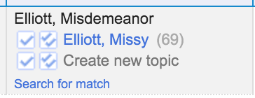
Notes:
So, matching occurs we see in OpenRefine using this service.
Holla!

Slide 14
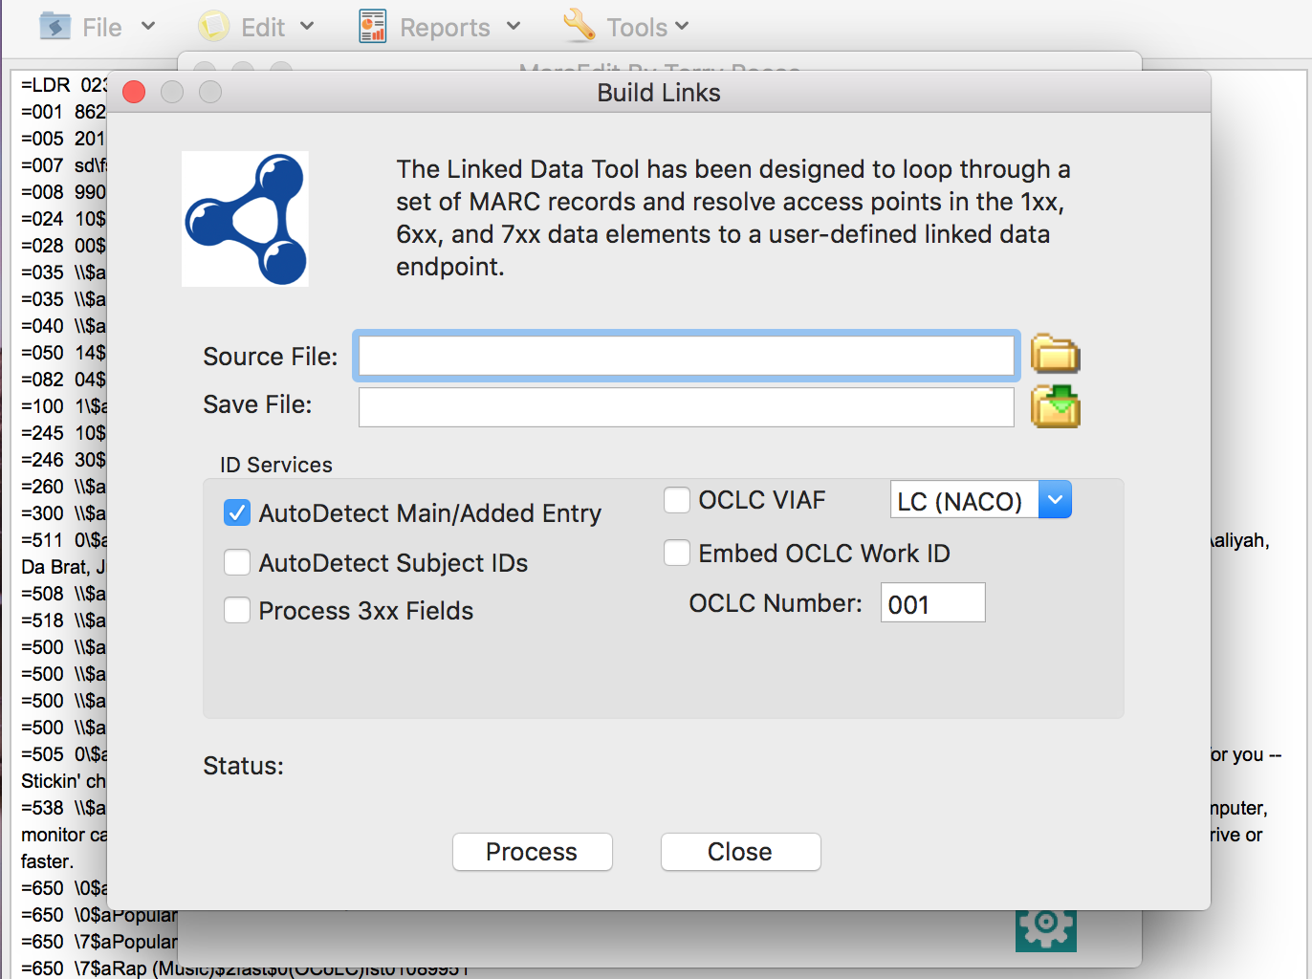
Notes:
This project need was also soon expressed in MARC Functions as well – in particular, for replacing Authority Vendor functionalities my previous job couldn’t afford, and NACO (Name Authority File record creation) commitments we couldn’t support. We see a lot of data ingenuity comes about by working around unsustainable data management workflows like those of NACO.
With MARCEdit, you’ve got similar functionalities, based off of controlled headings in MARC and matching with primarily the Library of Congress Headings and/or OCLC services - VIAF, FAST.
So…

Slide 15
Notes:
More matching! See the URI in the subfield 0.
Holla!

Slide 16
Is it worth it, let me search it…
Notes:
But we quickly see where these services hit their limits.
At first, just automatic querying of APIs in various interfaces was a coup, but there were mis-matches. There were lack of matches. There was needed normalization. There was missing data. For OpenRefine (and LODRefine), there was a lack of maintainers for the tools, meaning functionalities like the SPARQL Reconciliation Service became just a glimpse of what we could have… (hint, java developers in the room).
I started to load more and more fine tuning in my own reconciliation API functionalities for OpenRefine, but as the data munging to support and rank matching began to get more and more involved, and as the datasets began to get bigger and bigger, we saw the limits of these tools (and APIs).
What about the external data we queried?

Slide 17
id.loc.gov/authorities/suggest/?q=Elliott, Missy
["Elliott, Missy",
["Elliott, Missy"
],
["1 result"
],
["http://id.loc.gov/
authorities/
names/no97050913"
]
]
<idservice:service … >
<idservice:term
term-type="authorized"
score="16”
uri="http://id.loc.gov/
authorities/
names/no97050913">
Elliott, Missy
</idservice:term>
</idservice:service>
id.loc.gov/authorities/names/
didyoumean/?label=Elliott, Misdemeanor
Notes:
In accessing the Library of Congress APIs at id.loc.gov
We see that there is a different API for querying preferred labels from querying that of alternate labels, and the former returns JSON, while the latter, XML.
An extra layer of data munging there.

Slide 18
Tellico (meaning Great Tellico)
http://www.wikidata.org/entity/Q5600079
Tellico Archaeological Project
id.loc.gov/authorities/names/n86034608
Tellico Village (Tenn.)
id.loc.gov/authorities/names/n2003032175
Notes:
Additionally with id.loc.gov, we ran into issues of:
- Timing out. LC is not built for successive queries.
- False positives for place names that we don’t want to see mismatched, such as a former Native American cities matched to the archaeological dig sites present at where those cities were (and how we began to approach solving this at my previous job is my presentation at Access last year, if you’re curious).

Slide 19
UTK Music Graduate
Student
Grace Lee
http://id.loc.gov/
authorities/names/
no2012072228
Notes:
With id.loc.gov, we also had false positives for people that we don’t want to see mismatched, such as our graduate students whose dissertations or masters theses we are adding to our catalog. They are finding their names linked to the wrong person.
We are here to serve them, not make them disappear. How could other data in the MARC record help stop this from happening?

Slide 20
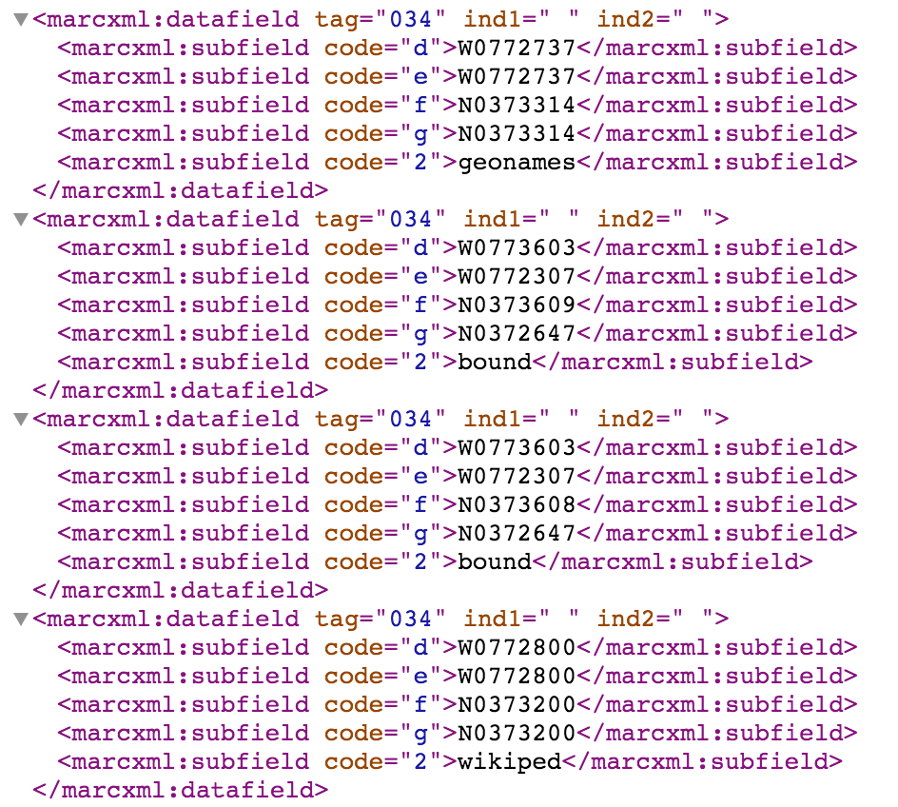
Notes:
Finally, with id.loc.gov, we saw that the granular aspects of records going from MARC to RDF - such as geographic coordinates…. (see here the MARC/XML 034 fields for the entry for Richmond (Va.))

Slide 21
<http://id.loc.gov/authorities/names/n79060700> <http://www.loc.gov/mads/rdf/v1#hasSource> _:bnode284authoritiesnamesn79060700 . _:bnode284authoritiesnamesn79060700 <http://www.w3.org/1999/02/22-rdf-syntax-ns#type> <http://www.loc.gov/mads/rdf/v1#Source> .
_:bnode284authoritiesnamesn79060700 <http://www.loc.gov/mads/rdf/v1#citation-source> "GeoNames, algorithmically matched, 2009" .
_:bnode284authoritiesnamesn79060700 <http://www.loc.gov/mads/rdf/v1#citation-note> "(ppl; 37°33ʹ14ʺN 077°27ʹ37ʺW)"@en .
… [my edits]”
<http://id.loc.gov/authorities/names/n79060700> <http://www.loc.gov/mads/rdf/v1#hasSource> _:bnode292authoritiesnamesn79060700 . _:bnode292authoritiesnamesn79060700 <http://www.w3.org/1999/02/22-rdf-syntax-ns#type> <http://www.loc.gov/mads/rdf/v1#Source> .
_:bnode292authoritiesnamesn79060700 <http://www.loc.gov/mads/rdf/v1#citation-source> "Wikipedia, June 2, 2015" .
_:bnode292authoritiesnamesn79060700 <http://www.loc.gov/mads/rdf/v1#citation-note> "(Richmond, Virginia; City of Richmond; capital of the Commonwealth of Virginia; 37°32ʹN 77°28ʹW) … [my edits]”@en.
Notes:
…well that granularity was lost going to the RDF serializations. The coordinates, where they do appear in MADS N-Triples, become a MADS:citation-note asserted on blank nodes.

Slide 22
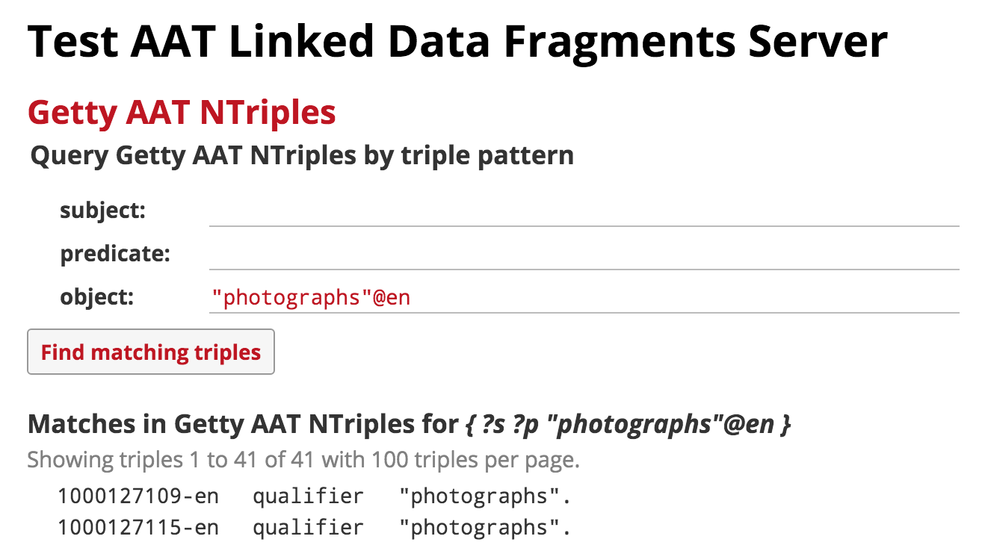
Notes:
To be an equal opportunity data access critic…
The Getty SPARQL Endpoint (or any endpoint it seems that is not Virtuoso, it appears) doesn’t work with the LODRefine SPARQL Reconciliation Extension.
The data dumps were too big for managing on my local machine - perhaps a place for Linked Data Fragments to come in, which I tested for more efficient querying of the Getty Vocabs available as RDF download. The next talk will go into LDF more.

Slide 23
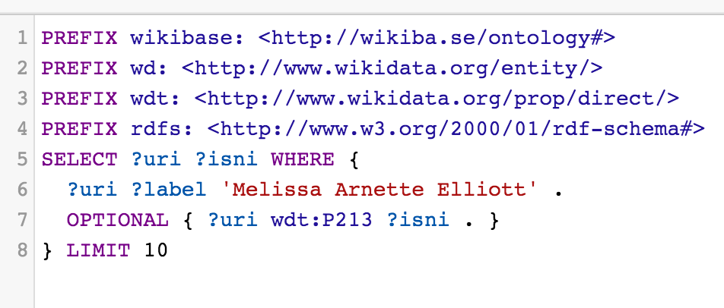
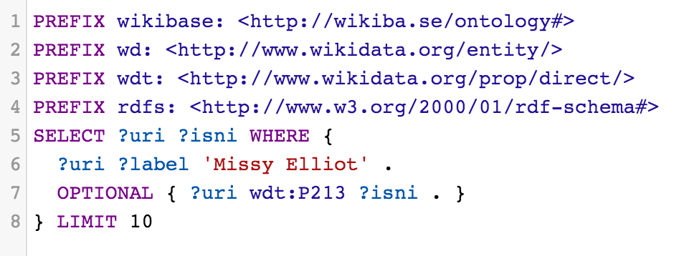
Query.
wikidata.org:
No fuzzy matches
Notes:
With Wikidata, there was:
Surprising amount of information from their SPARQL endpoint linking authority records across sources, but…
No fuzzy matching when doing label searching. Really. None. This could be good or bad, as some data sources presume too much in setting up their own matching algorithms.
Though it has some very good identifier reconciliation...
And these are just the most pressing data access examples in my head.

Slide 24
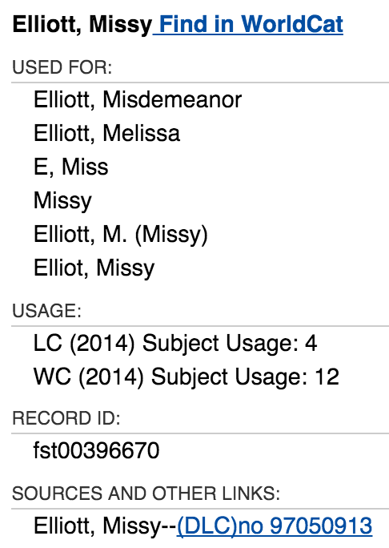
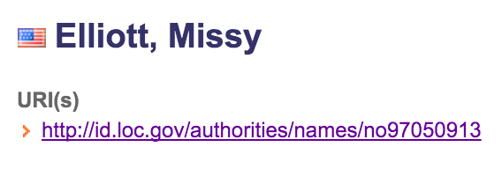
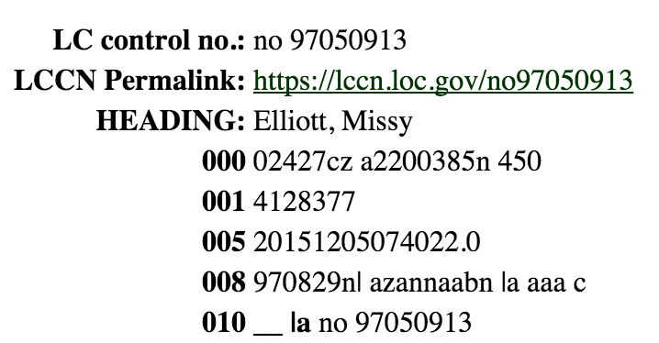
Notes:
Mentioning identifiers matched in wikidata, we’ve got the capability here to expand the points we can match on through a network of external data. This is the blue sky vision of my reconciliation work now.
But look at how even the formulation of these linking identifiers varies:
FAST in Wikidata is just numbers (the top).
FAST in FAST is fst-00-numbers (to a certain number of digits).
FAST in MARC records is generally (OCoLC)fst123456.
Library of Congress identifiers in FAST follow the MARC style for LC control numbers – but not the URI conventions for id.loc.gov.
While you can somewhat get the variance, there is required data munging just to get the identifiers to match.

Slide 25
If we can’t even agree on how to represent the identifiers we have captured…
Notes:
If we can’t even agree on how to represent the identifiers we have captured… like whoa the amount of data munging needed to make reconciliation happen.

Slide 26
The linked data that you doing is … incomplete
Notes:
To fully realize the benefits of Linked Data, a huge amount of entity matching / data remediation work needs to occur - not just in general maintenance, though that is important, but in huge shifts of datasets.
All of this has led to my experimentation/work of the last few months, looking at what amounts to some data remediation and entity matching we need to have occur for, if nothing else, many of the promises of linked data that we’re actively working on now to happen.
To accomplish this, I’ve begun experimenting with some matching algorithms and external data API querying that can help avoid false positives, data matching false negatives, and general normalization work needed to make data sources discussed talk to each other, much less our own metadata.

Slide 27
Ex: Personal Names in MARC
Have a $0:
Link to LC or FAST, query Wikidata
Have a $d, $q, $b, or $c:
Query LC, if ID, query Wikidata, VIAF…
Does name match names in another source &:
Work title matches in VIAF, Wikidata?
Role terms matches in Wikidata, VIAF?
Affiliations matches in LC, VIAF, Wikidata?
Notes:
For Personal Names in MARC, I basically follow this querying and matching pattern. A very basic score is generated through levenshtein distance generation, when identifiers are not present.

Slide 28
Ex: Personal Names in IR DC/XML
Have an URI:
Dream on.
Does it match regex pattern for life dates:
Query LC, VIAF
Does name match names in another source &:
Work title matches in VIAF? Wikidata?
Role terms matches in Wikidata, VIAF?
Subject matches in VIAF, Wikidata?
Notes:
For personal names in our Institutional Repository, there is a similar method, though we focus on different matching points because we have different assumptions/understandings of the data we start with.

Slide 29
Stumbling towards this:
"ocm37254335 _LaRue, Chi Chi":{
"query":"LaRue, Chi Chi, 1959-",
"matches":{"viaf":[
{"viaf_score": 100,
"viaf_prefLabel": null,
"viaf_uri":"http://viaf.org/viaf/74729412"}],
"lc":[
{"lc_prefLabel": "LaRue, Chi Chi, 1959-",
"lc_score": 90,
"lcnaf_uri": "http://id.loc.gov/authorities/n97067102"}],
…
Notes:
So this would be somewhat the result we get from running a Personal Names query.
We’re avoiding false positives, but we also need to be aware of how many names don’t get matched now, and how we can address this. Perhaps a queue system for manual review dependent on scoring?
But, I still think this deserves a ‘Holla!’

Slide 30
http://bit.ly/GetUrRecon
Notes:
Let me conclude with this.
In case you were wondering why all this Missy Elliott stuff…
Her music is perfect for data munging.
But more to the point, all of this crazy reconciliation workflow is duct taped by what is possible, what I've dreamed p, and what internal stake holders expect; I hope, this work comes across like Missy Elliott videos. A little bit crazy, but it works (and works with what you’ve got).
Thanks.

